Slide 1

Steganalysis In
Photographs
Presented by
Devadi Yekaditya
Mislah Rahman
Sriramsetty Bhanu Teja
Under the guidance of
Dr. Amit Ranjan Azad
INDIAN INSTITUTE OF INFORMATION TECHNOLOGY KALYANI

Slide 2

01 INTRODUCTION
02 STEGANOGRAPHY
03 STEGANALYSIS
04 DECODING
05 CONCLUSION

Slide 3


Multimedia
Text
Audio
Image

Slide 4
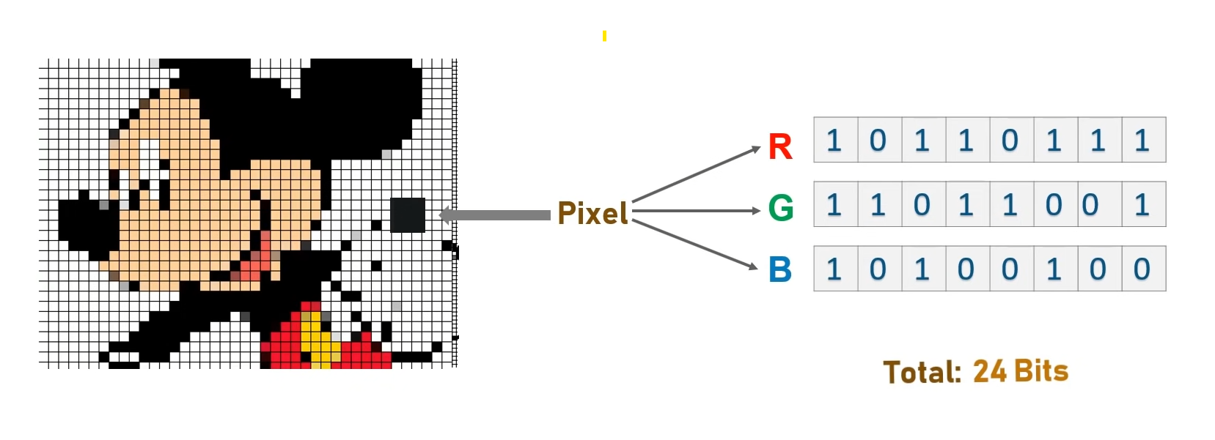

Image
Visual representation of depiction of something
Pixel

Slide 5

RGB COLOR MODEL
RGB uses combination of red, green, and blue channels to create various colors.
Each value in the Image Matrix corresponds to a color or Intensity at a specific location.

Slide 6
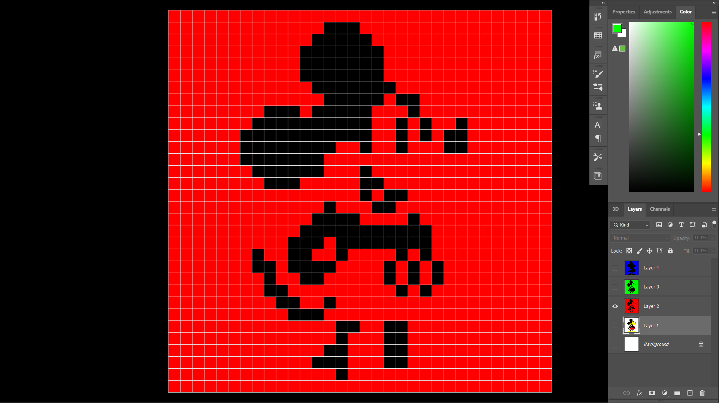
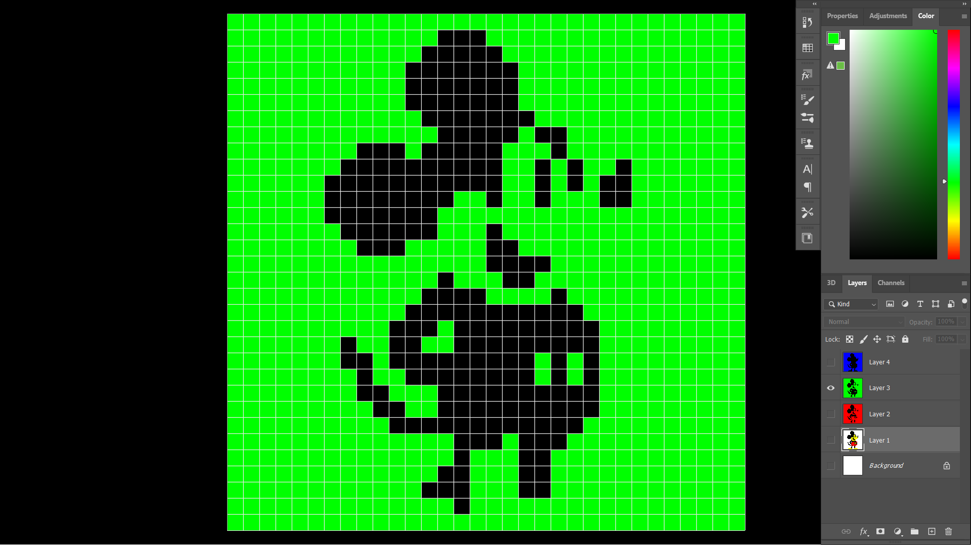
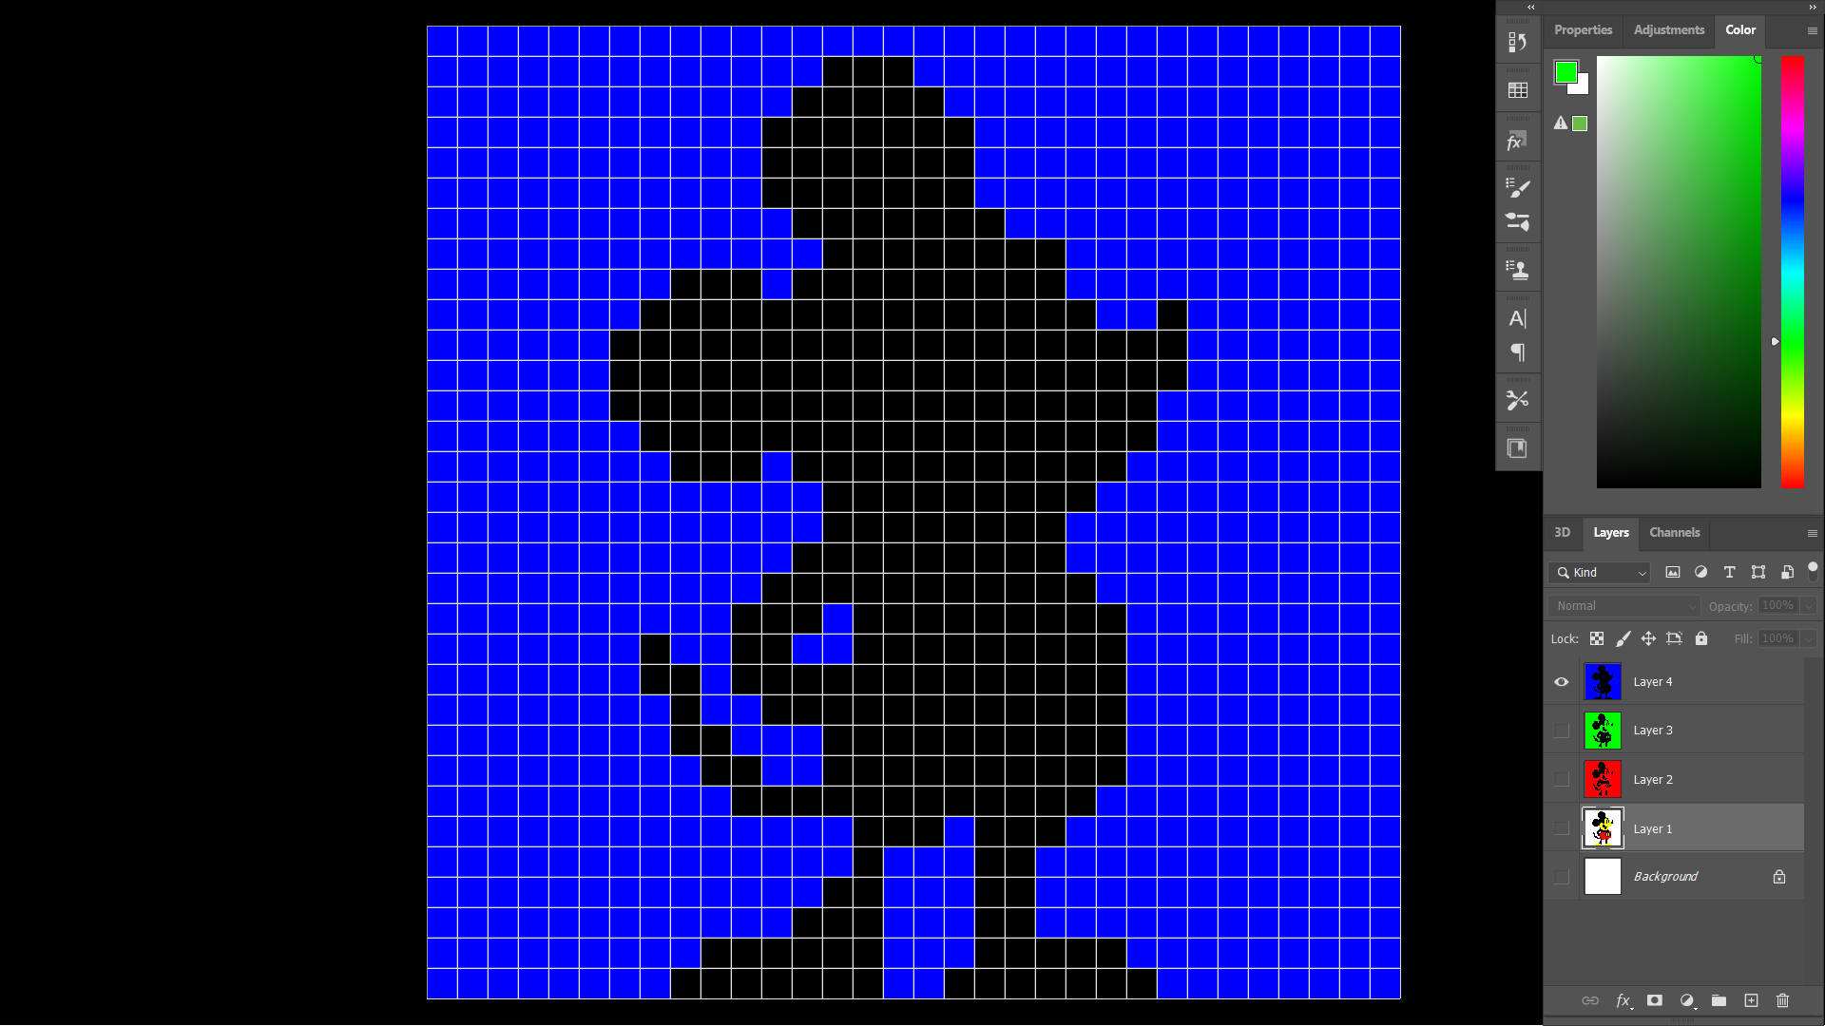
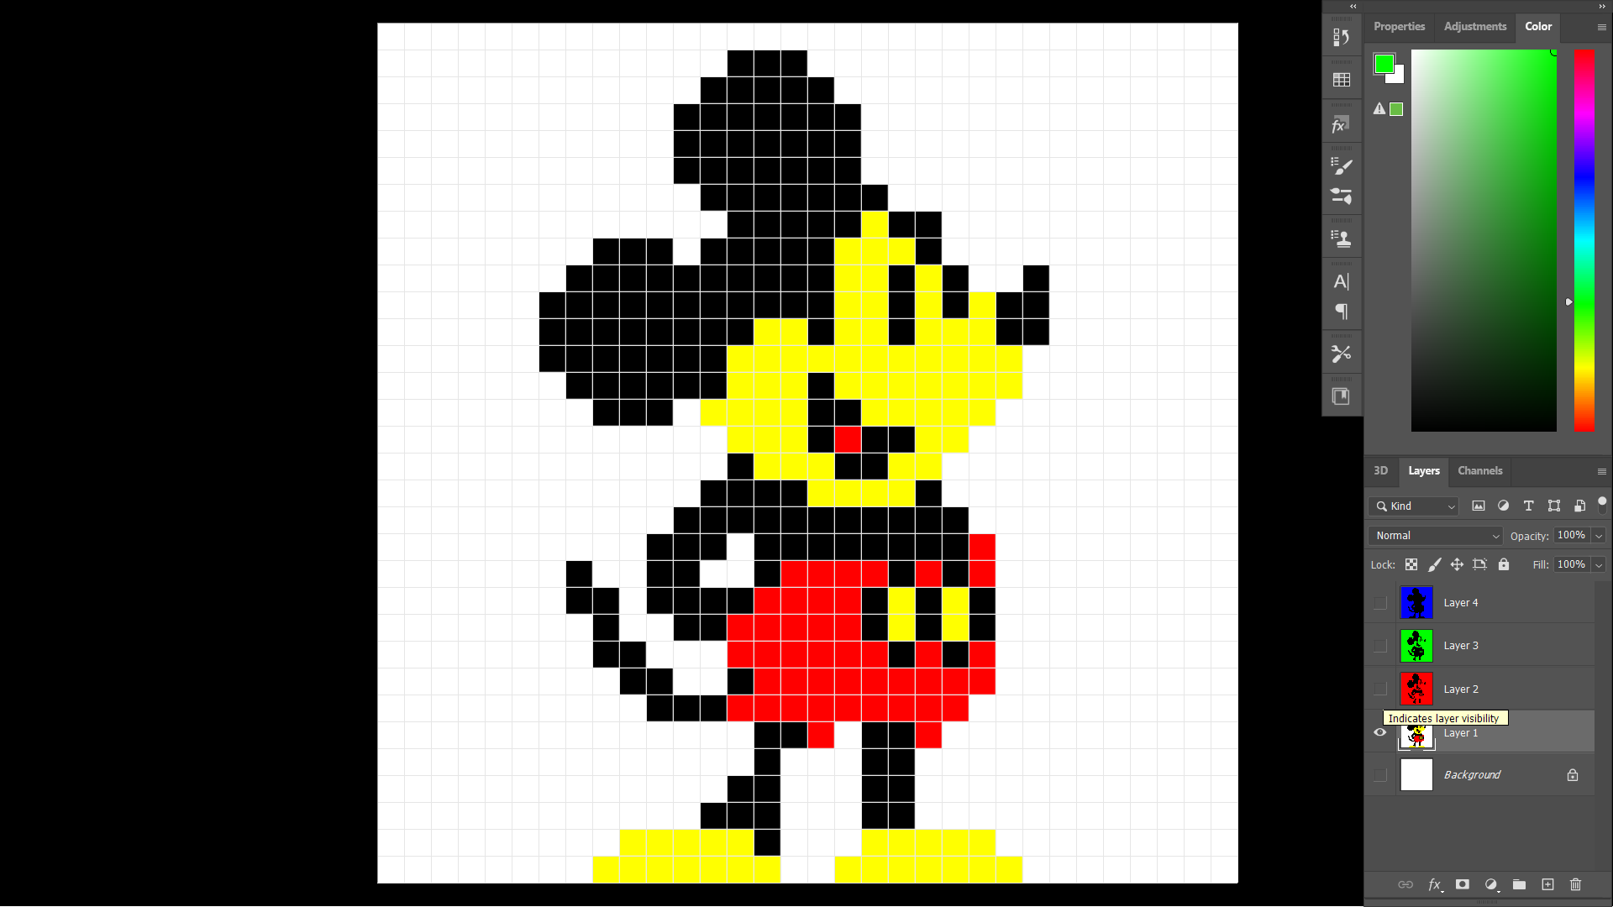
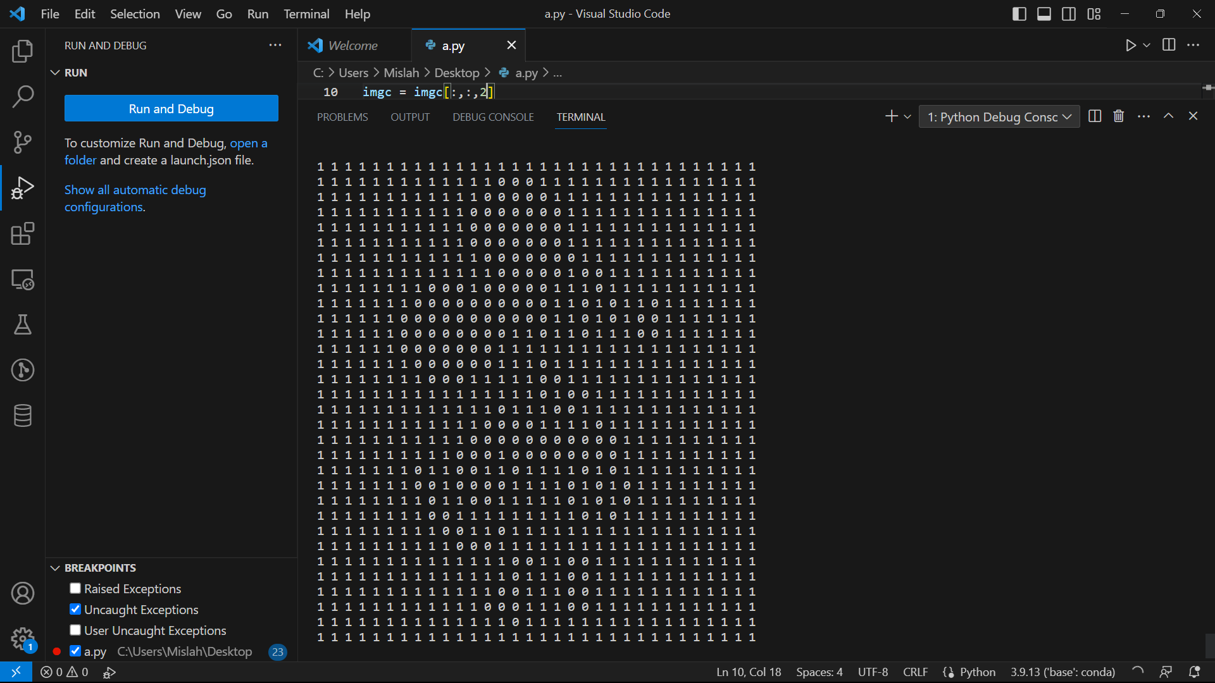
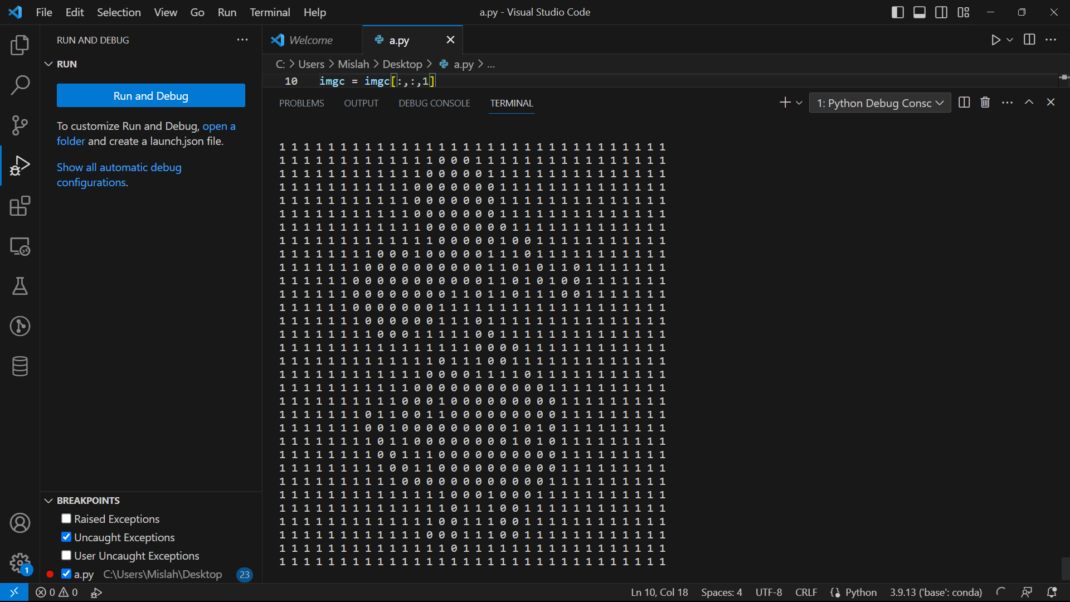
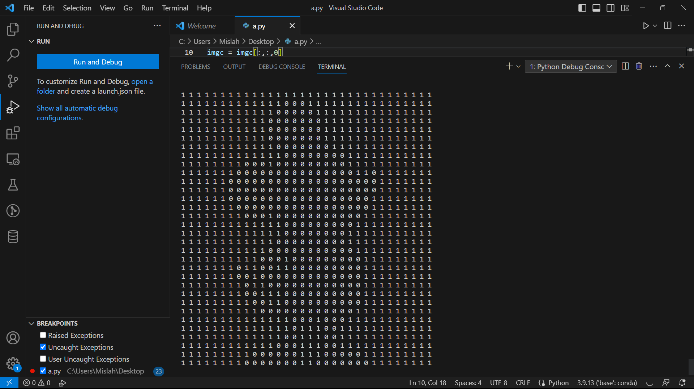
Matrix
Representation
Red
Green
Blue
3 Channel 1b depth
32x32p image

Slide 7
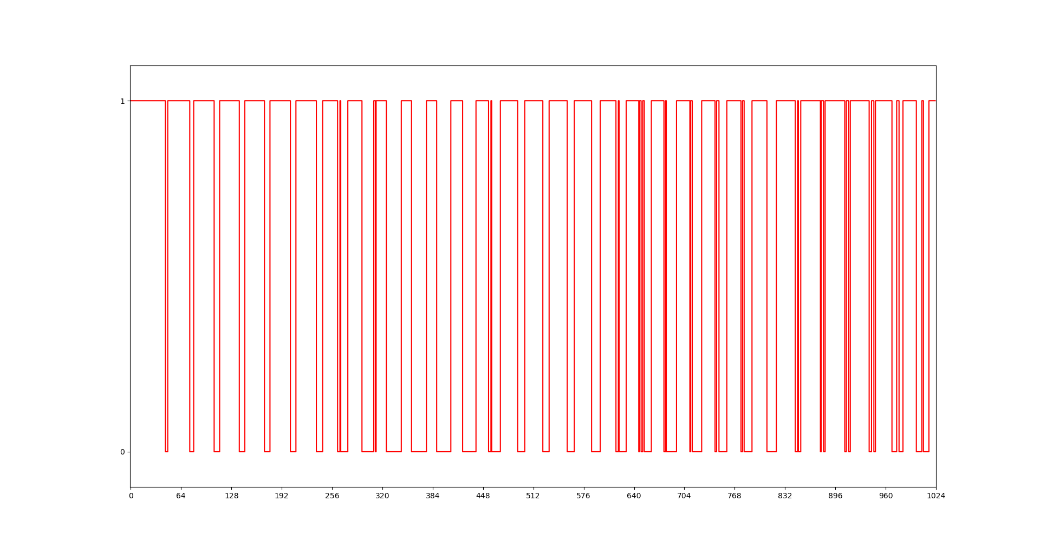
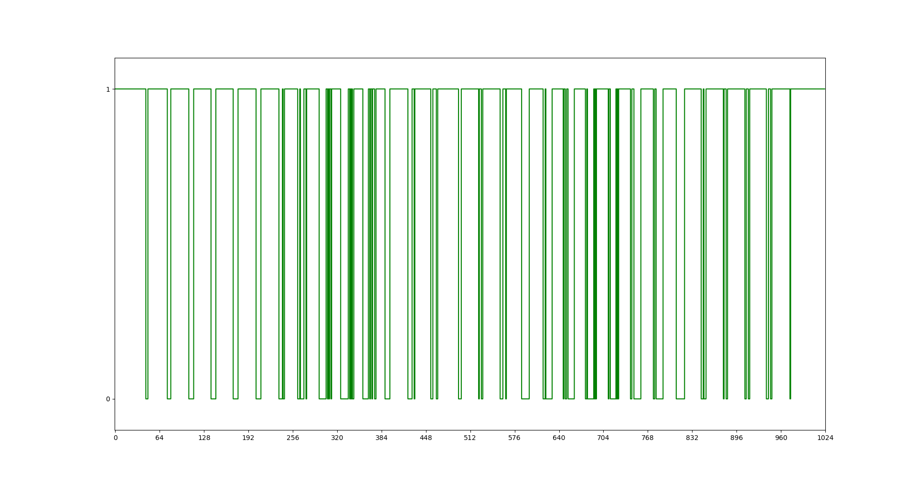
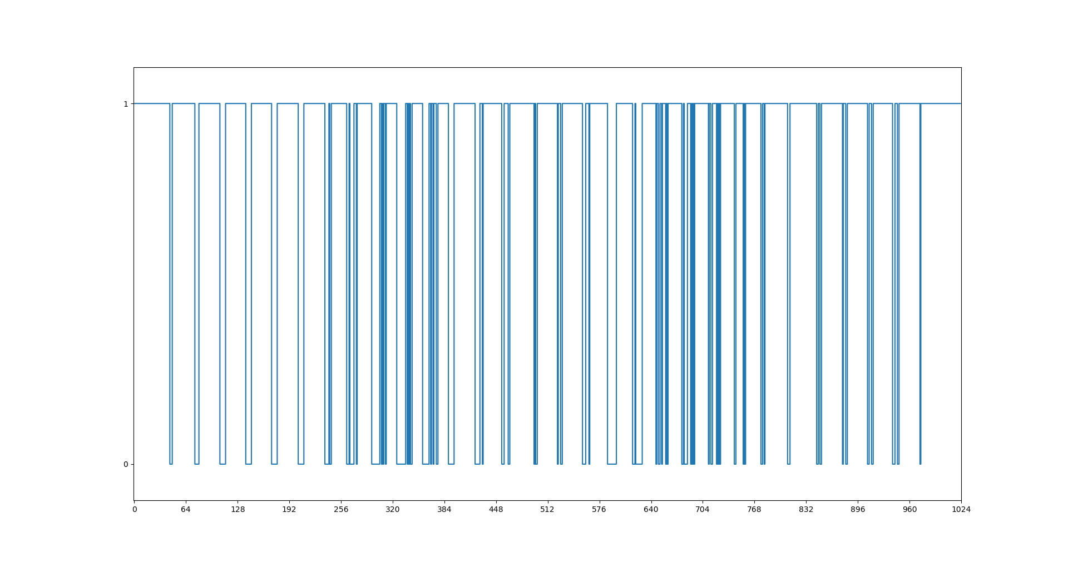
Signal Representation
Red
Green
Blue

Slide 8
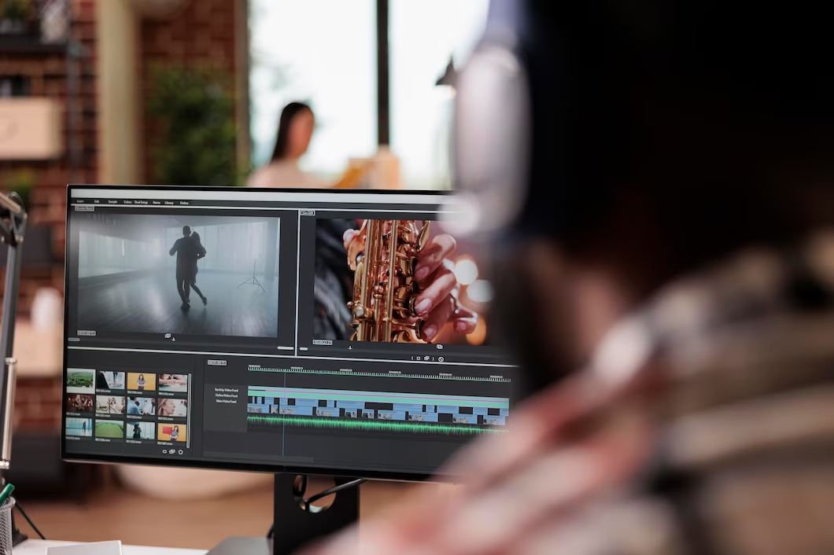
Image Compression
Image Compression is a process applied to a graphics file to minimize in bytes without degrading image quality below an acceptable threshold.
Types of Compression
Lossy
Lossless

Slide 9

Information Security
Cryptography
Steganography

Slide 10
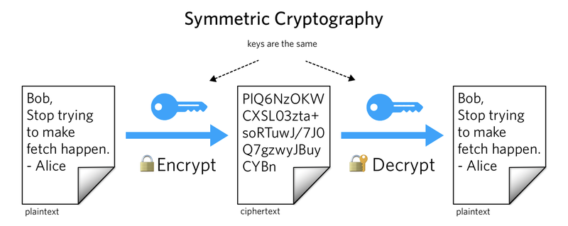
Cryptography
Hides information by encoding it. Information is unreadable without key.

Slide 11
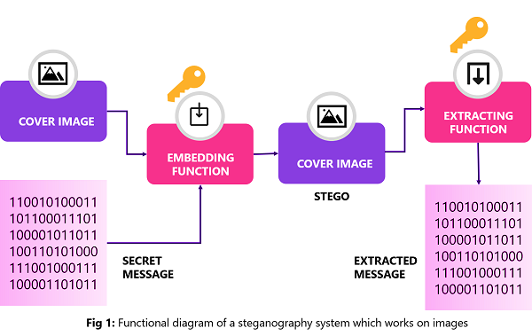
Steganography
Hides information by concealing it. The presence of information is not known.
Since everyone can read, encoding text in neutral sentences is doubtfully effective.
Since everyone can read, encoding text in neutral sentences is doubtfully effective.

Slide 12
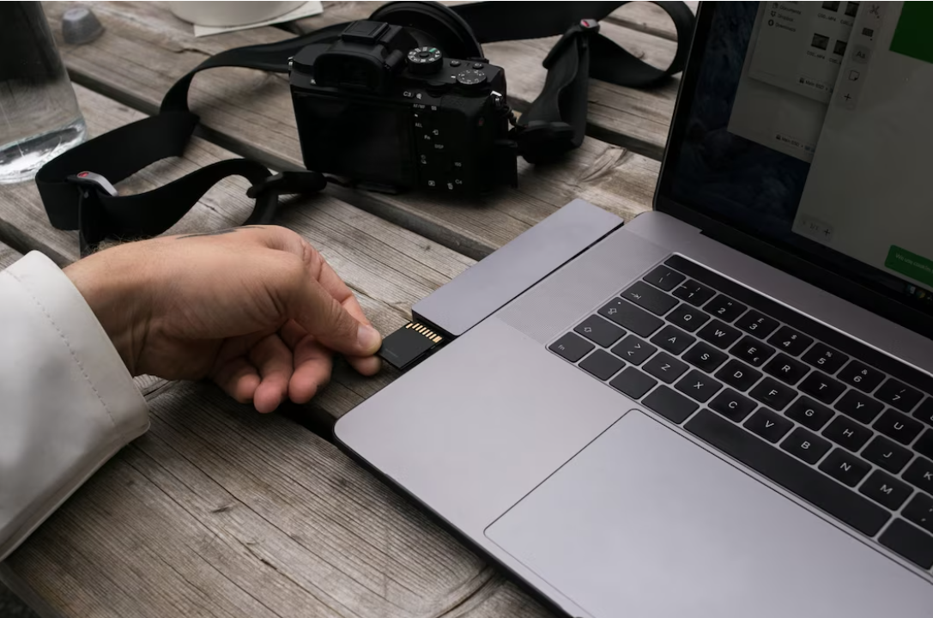
Types of Steganography
Spatial Domain
Frequency Domain

Slide 13
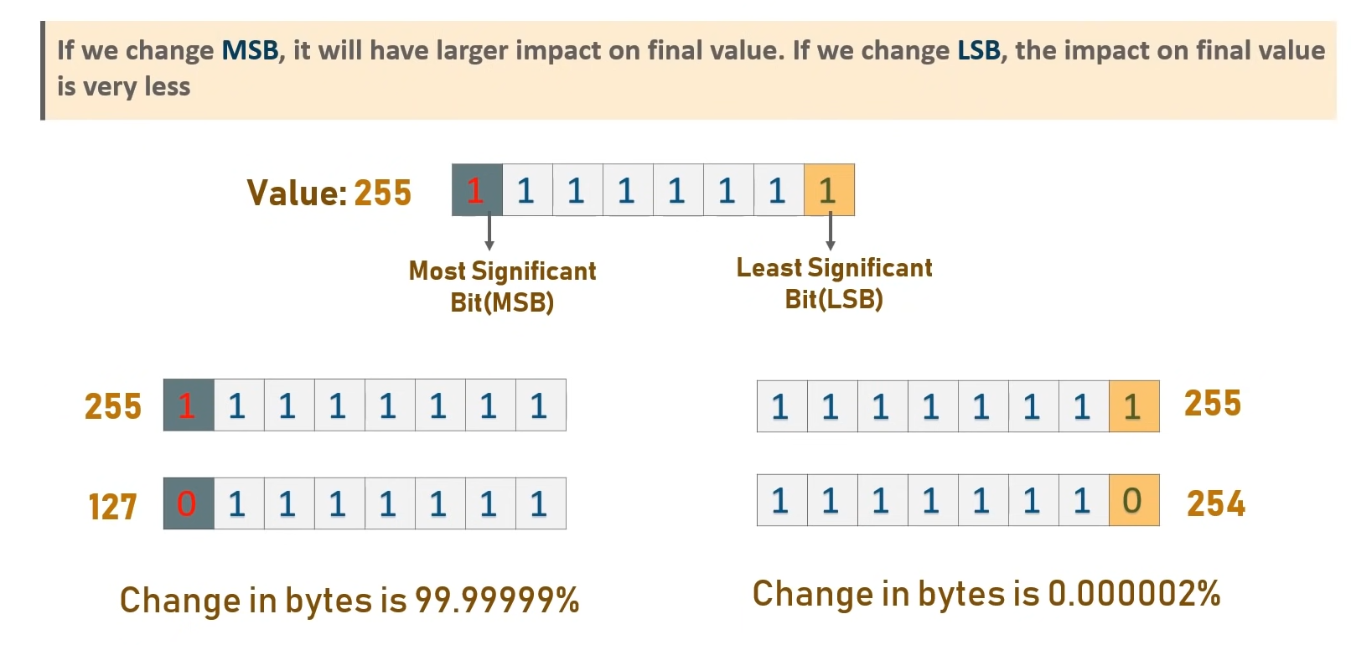
LSB Steganography

Slide 14
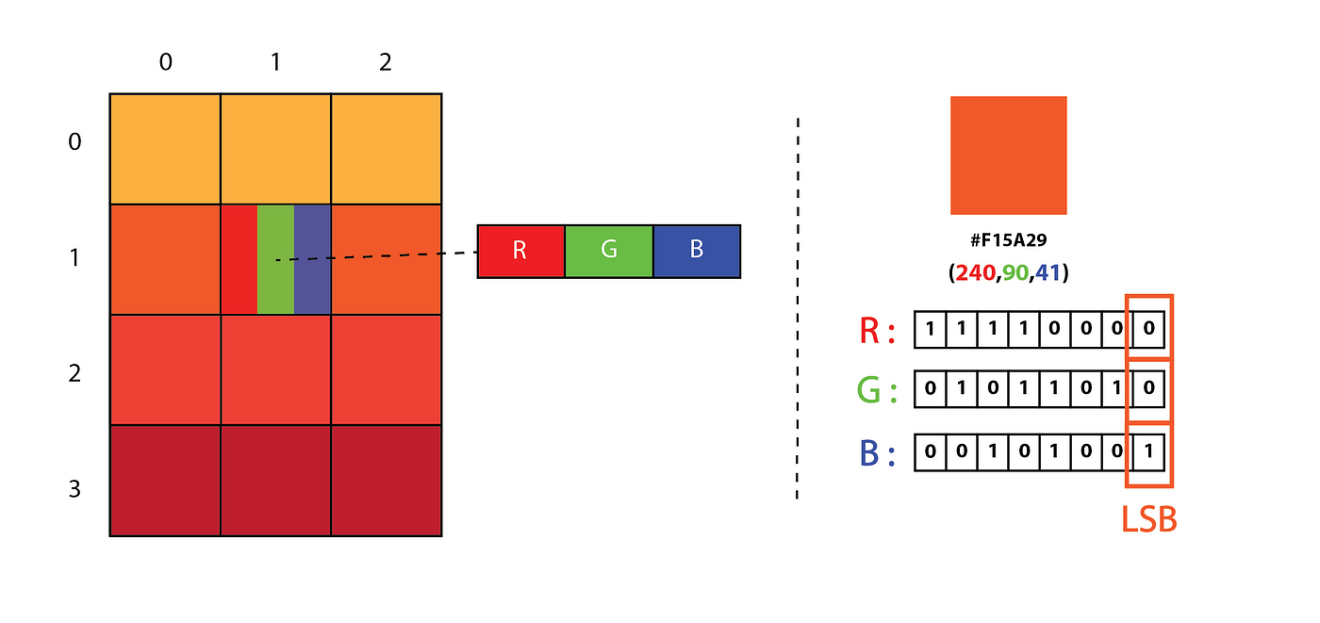

LSB Steganography
Edits the last few significant bits

Slide 15
Steganalysis
Detection and decoding of steganographic data.
Project Description
Detection and decoding of LSB steganography in photographs where cover media and payload are images.

Slide 16


LSB Steganography
+
=
Cover image
Payload

Slide 17
=
Embedded Image

Slide 18
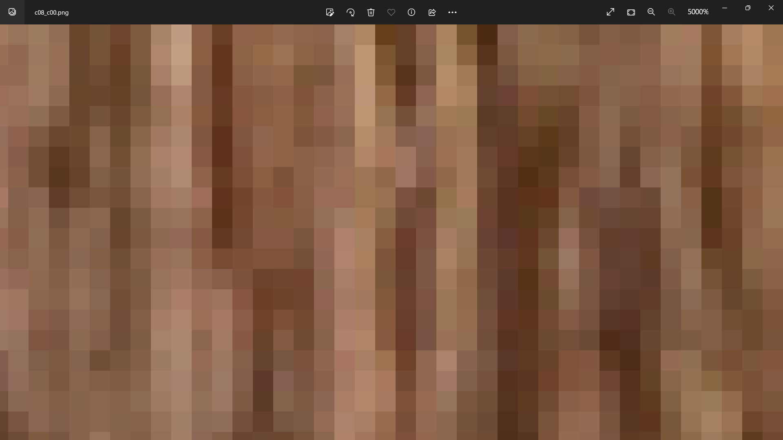
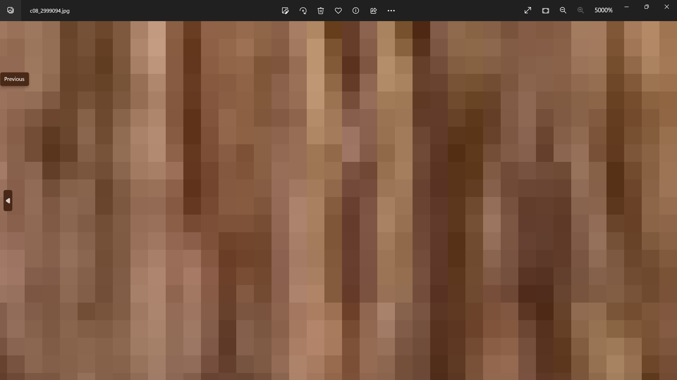
Cover image
Embedded Image

Slide 19
Cover image
Embedded Image

Slide 20
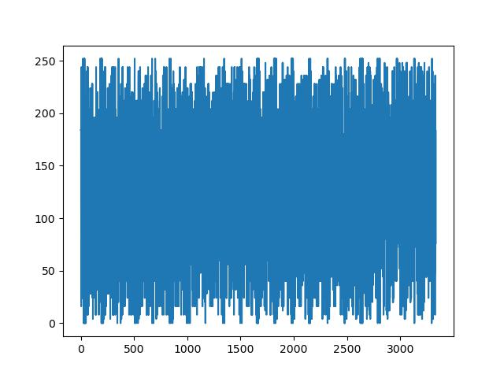
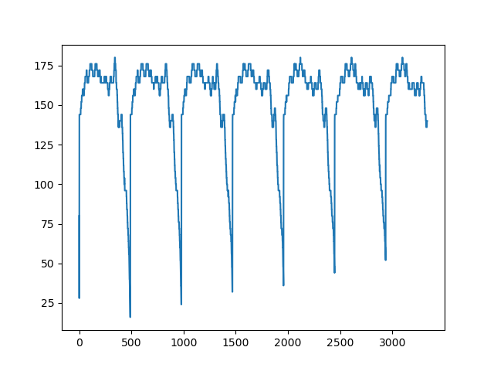
Cover image
Embedded image

Slide 21
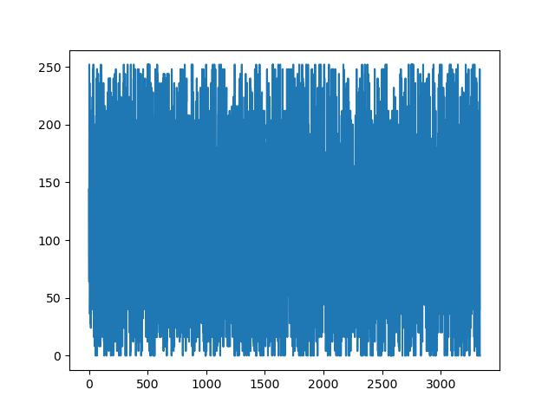
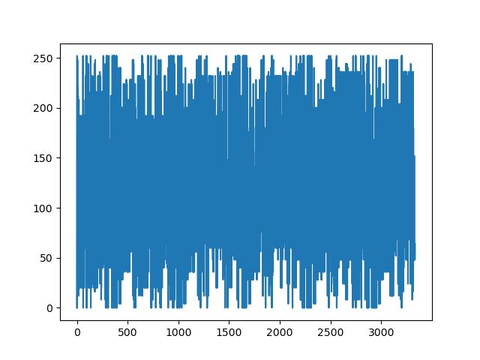
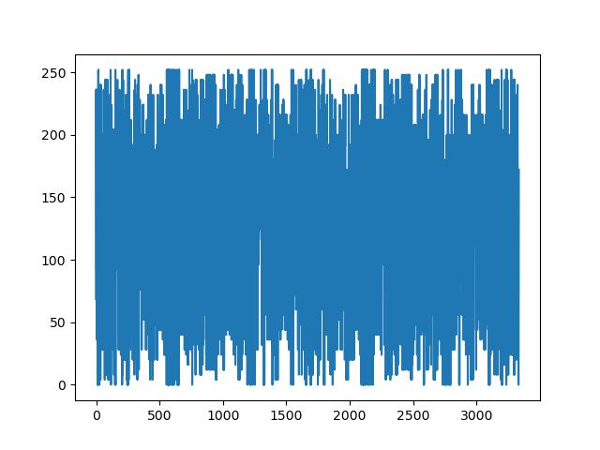
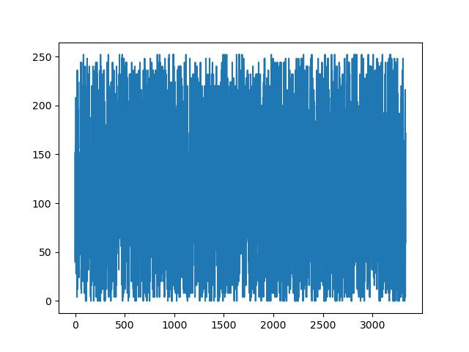
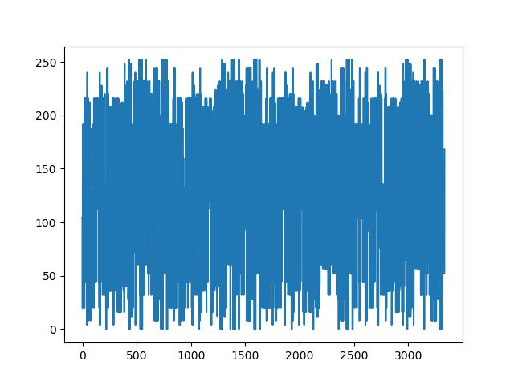
Observations
Photographs

Slide 22


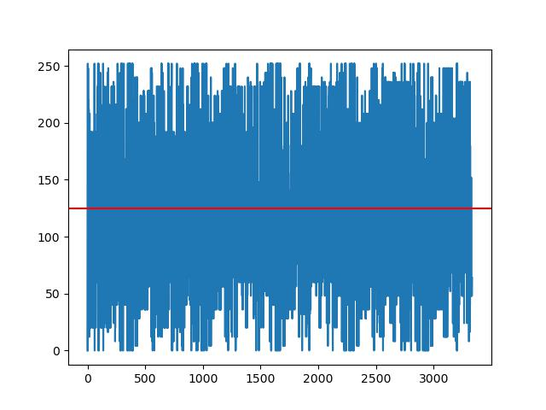

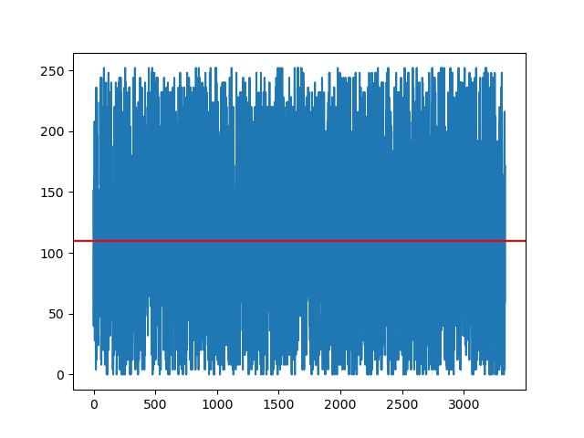

Observations
Photographs

Slide 23
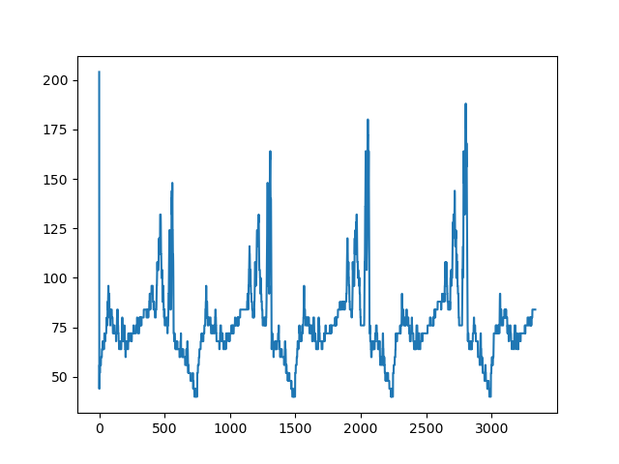
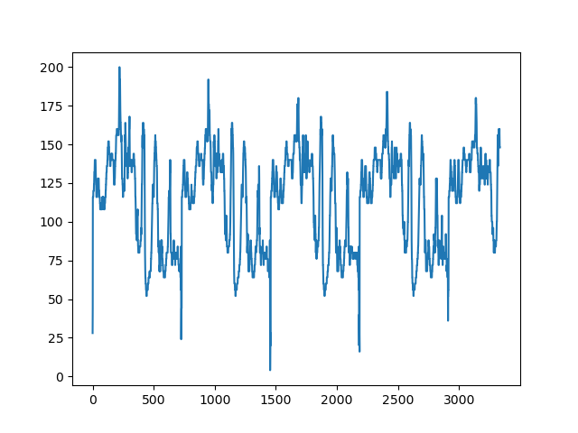
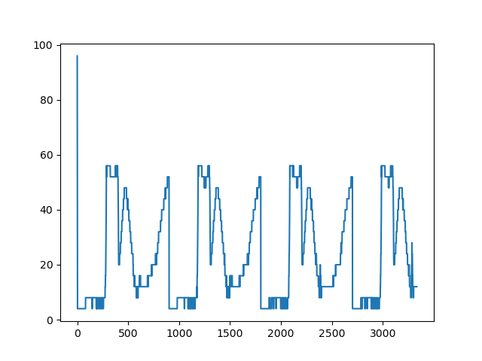

Observations
Embedded Images
Cover Images follows uniform distribution
Embedded images has repeating patterns.
Embedded images has high information density

Slide 24
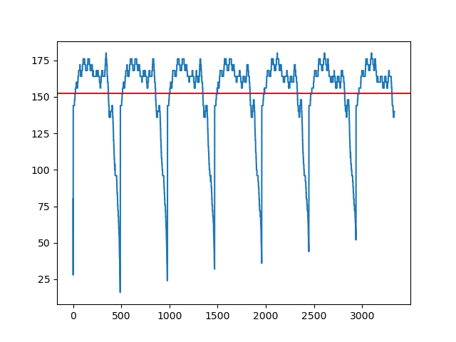
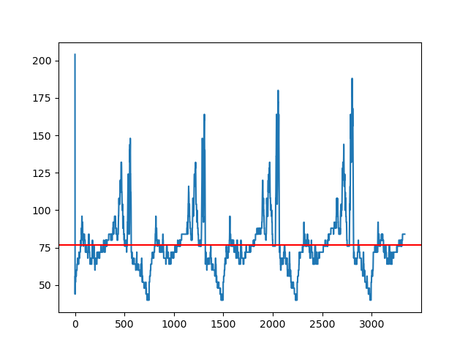
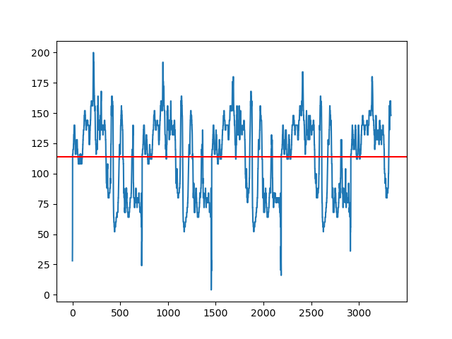
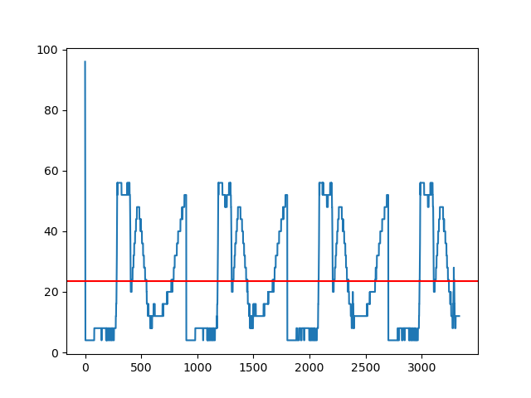
Observations
Embedded Images
Cover Images follows uniform distribution
Embedded images has repeating patterns.
Embedded images has high information density

Slide 25
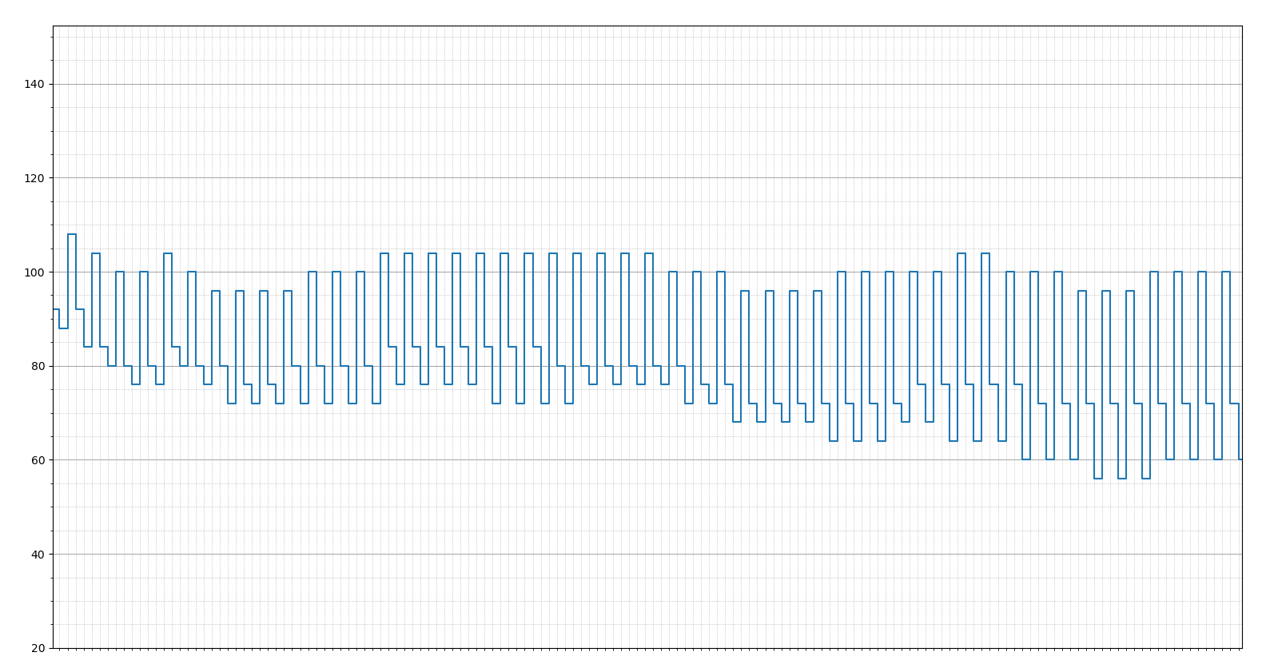
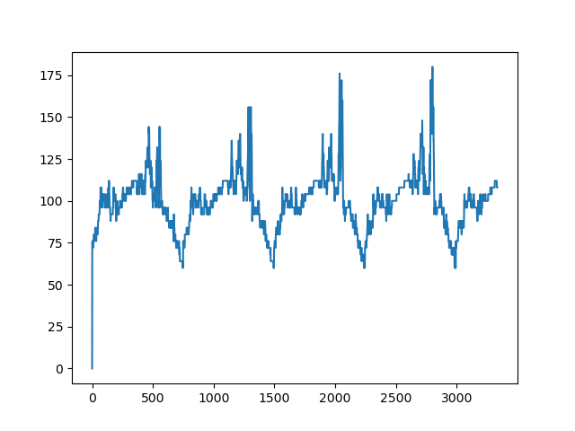
Statistical Analysis

Slide 26
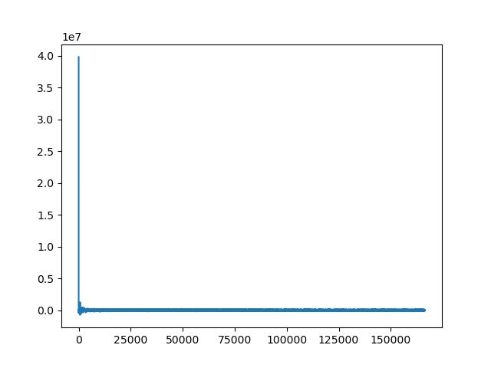
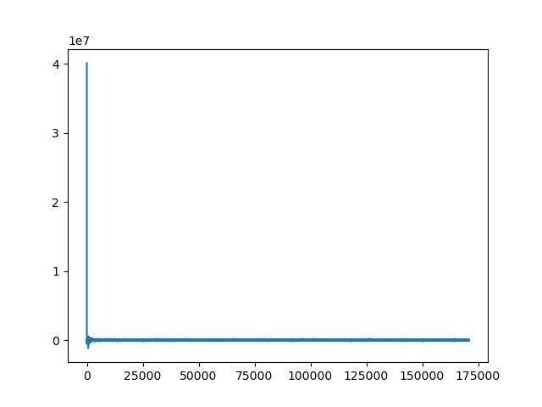
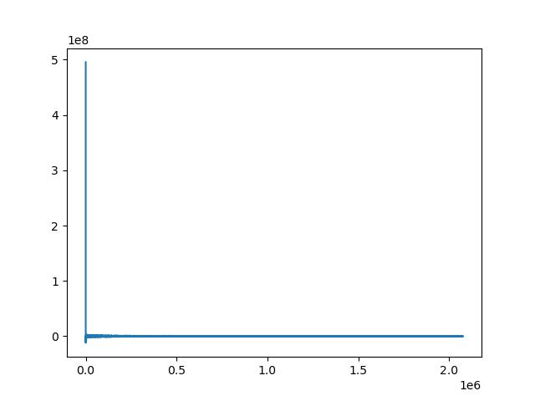
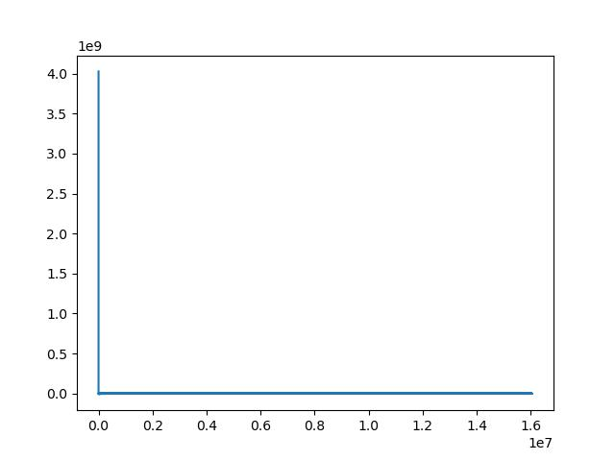
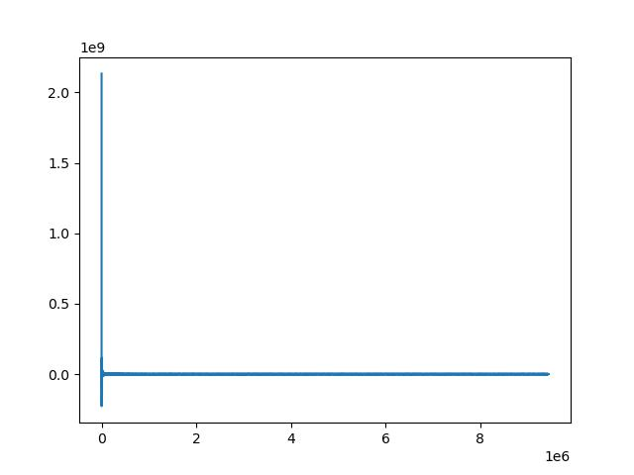
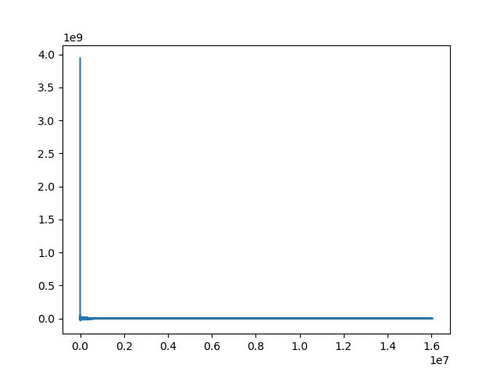
Discrete Cosine Transform
Photographs

Slide 27
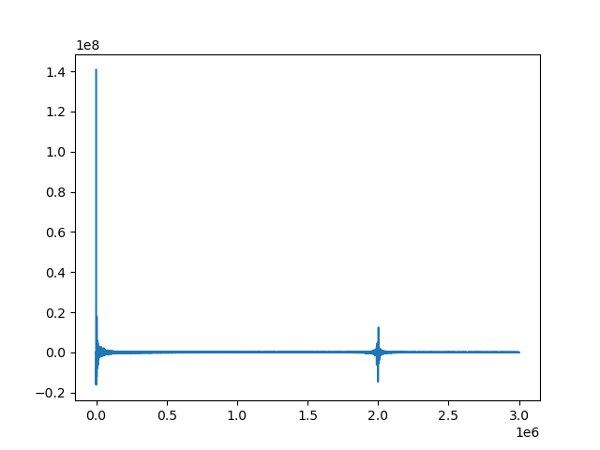
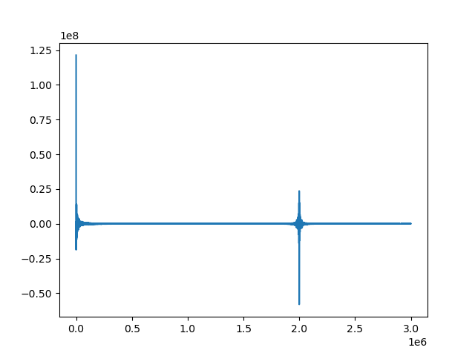
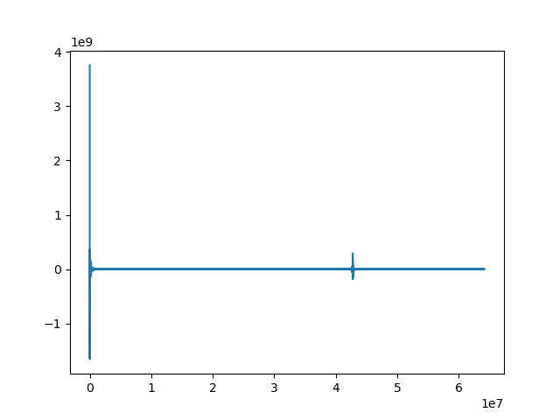
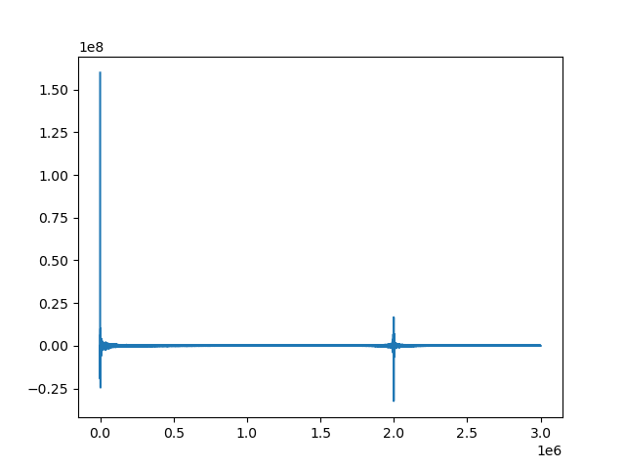
Discrete Cosine Transform
Embedded Image
Cover Images has a one very large spike near to zero
Embedded images two large spikes.

Slide 28

Decoding of Image
+
Cover image
Payload

Slide 29

Decoding of Image
Embedded Image

Slide 30
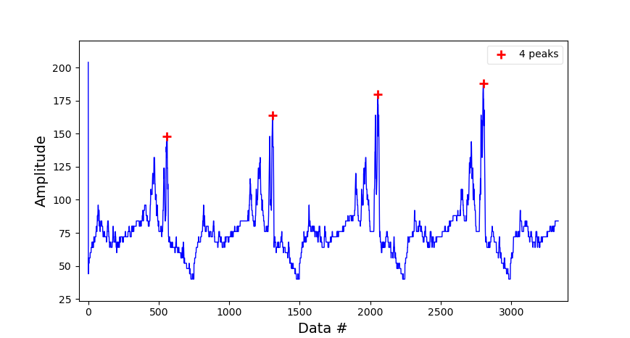
Decoding of Image

Slide 31
Decoding of Image
Mean distance between peaks = 747
748
745
749
Original dimensions
of payload image: 748 x 499

Slide 32
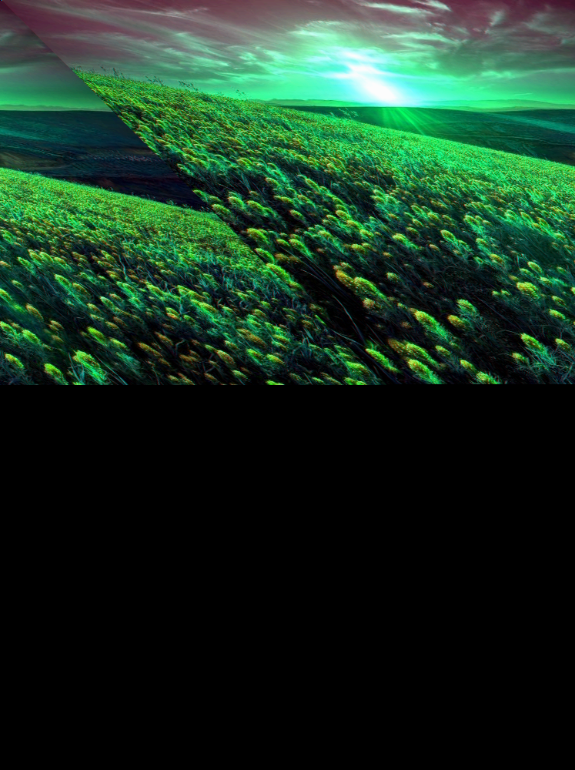


Decoding of Image
width = mean
Before channel offset correction
width = mean
After channel offset correction
width corrected
After channel offset correction

Slide 33

Future Scope
Machine learning to detect patterns more accurately
Add pattern analysis to detect height

Slide 34
Application
Information security and Intelligence
Prevention of cyberthreat
Digital forensics
Media integrity verification

